Slide 1
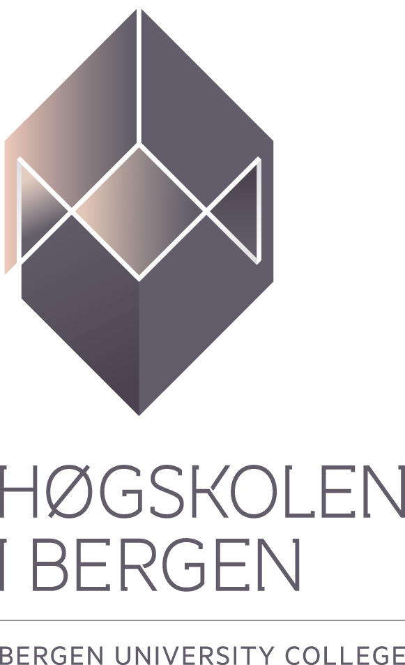
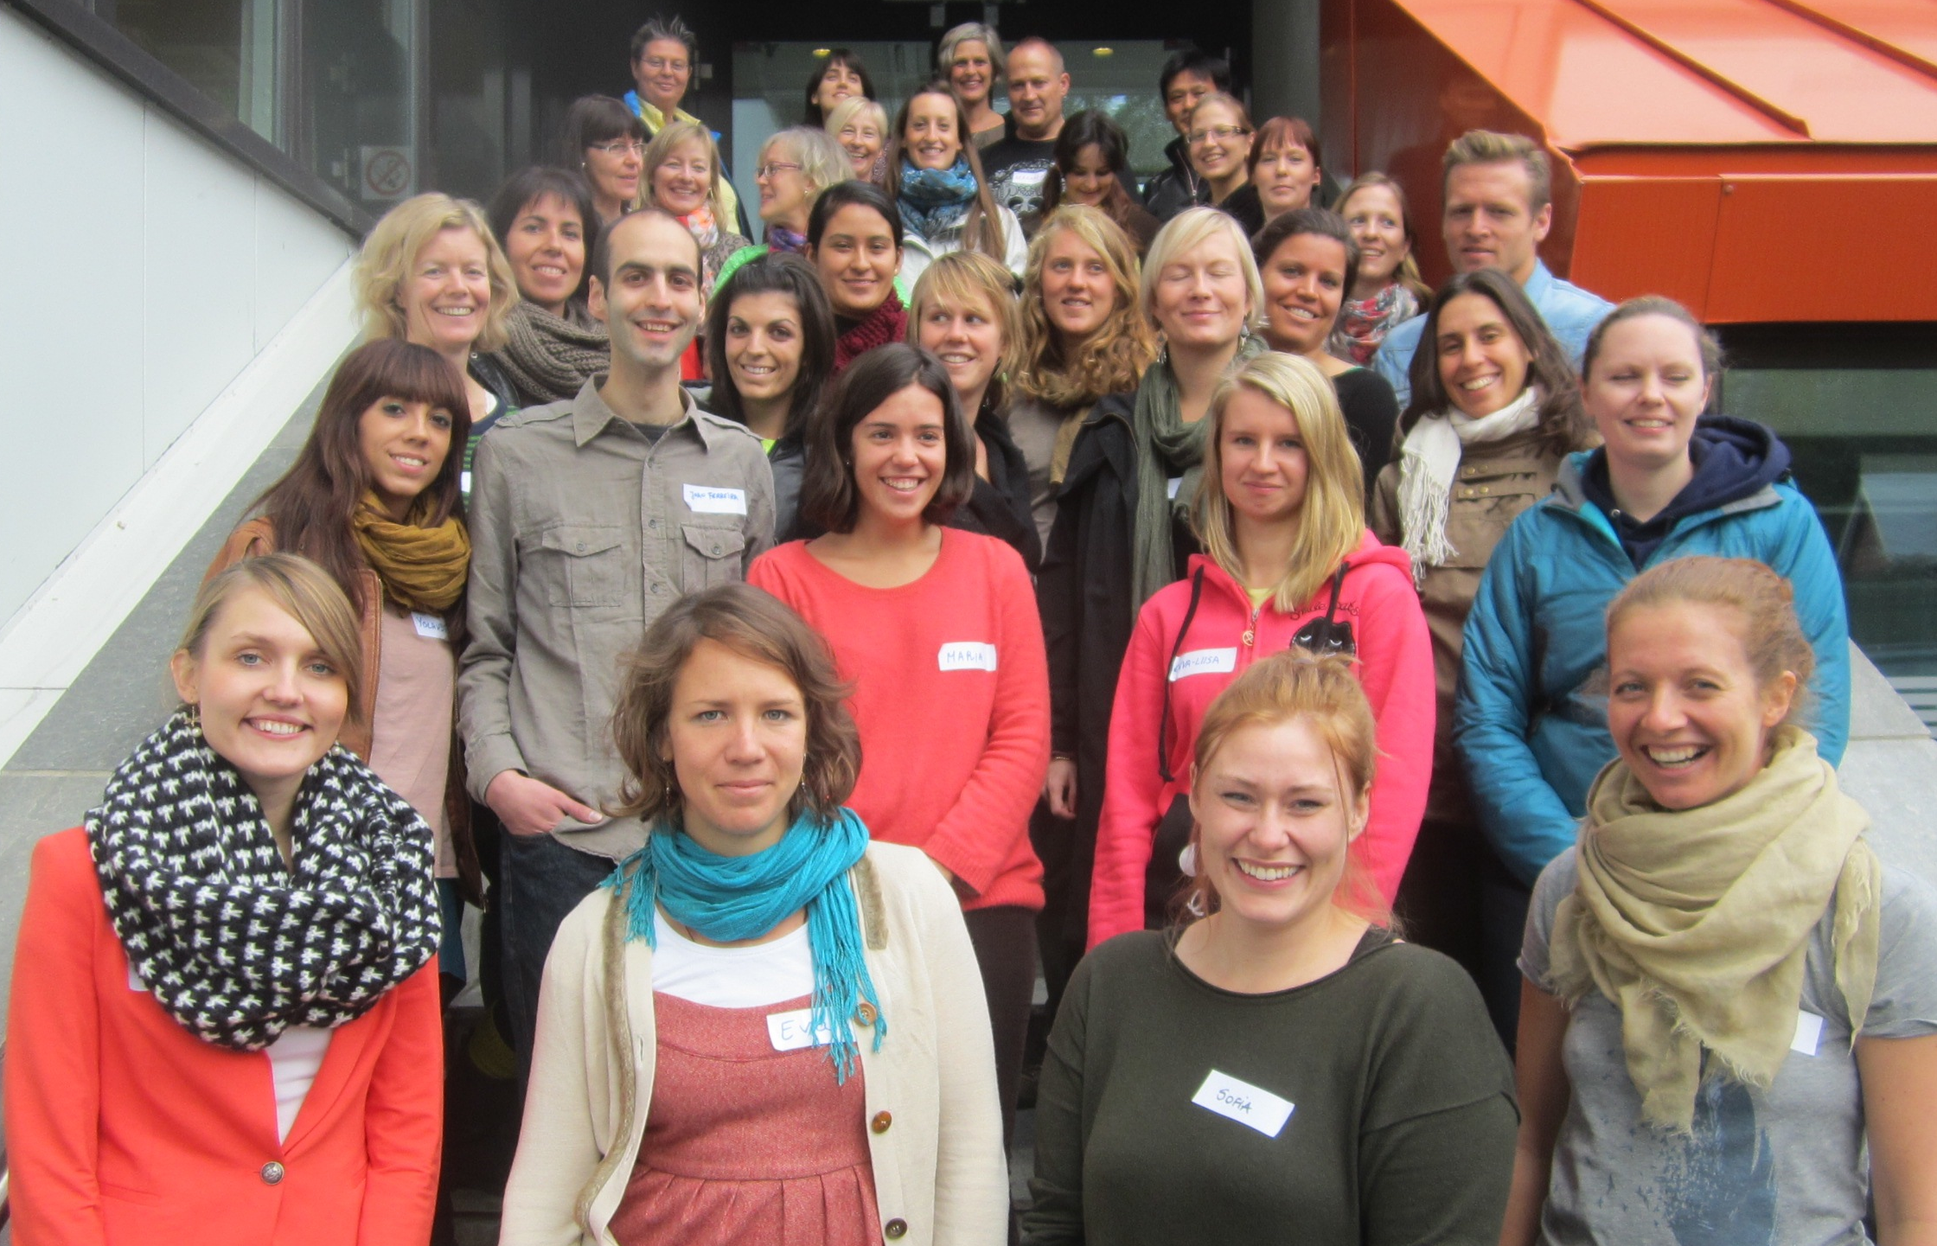
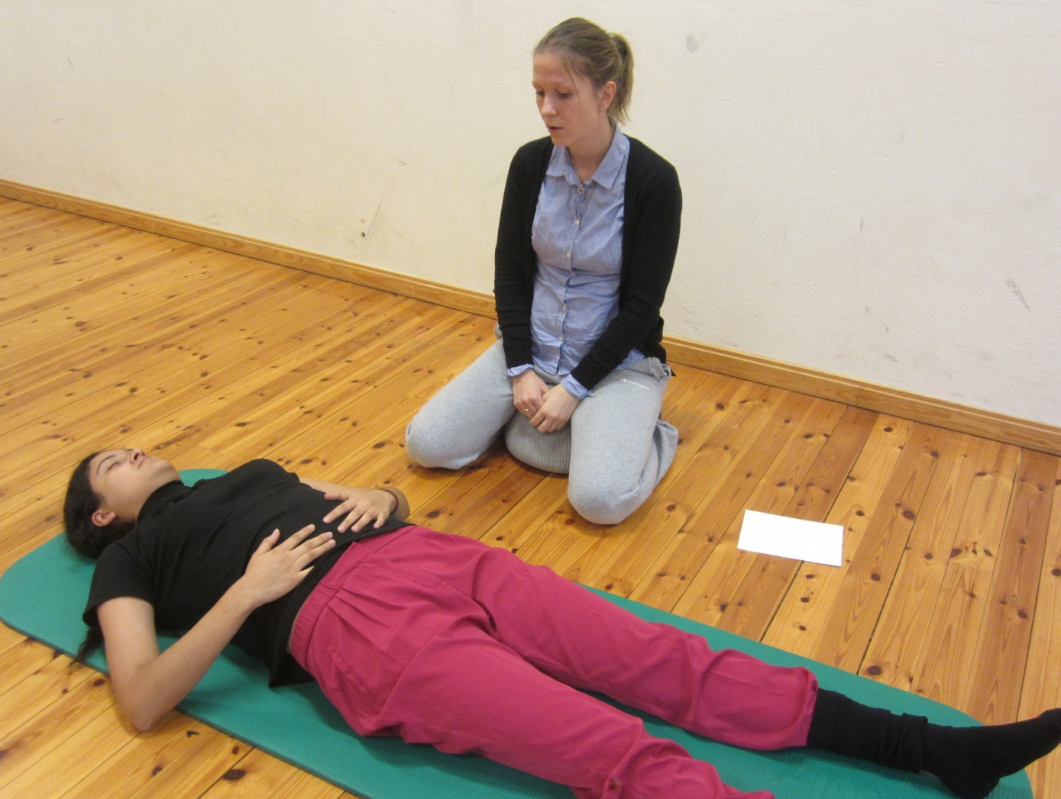
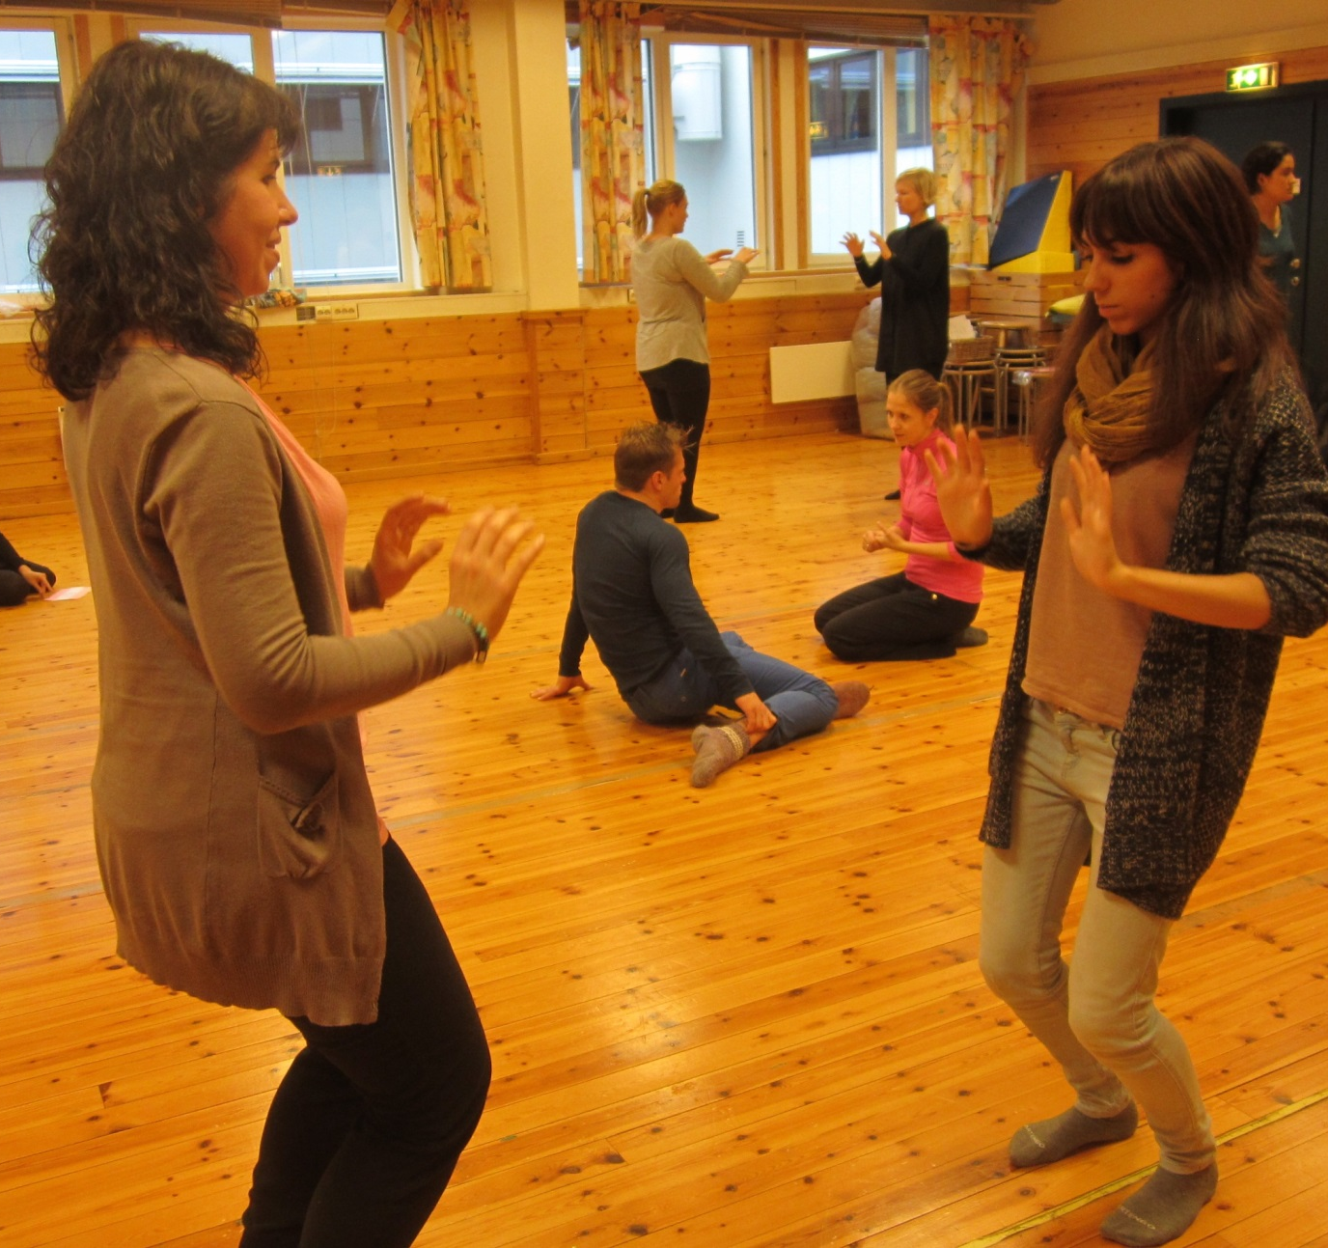
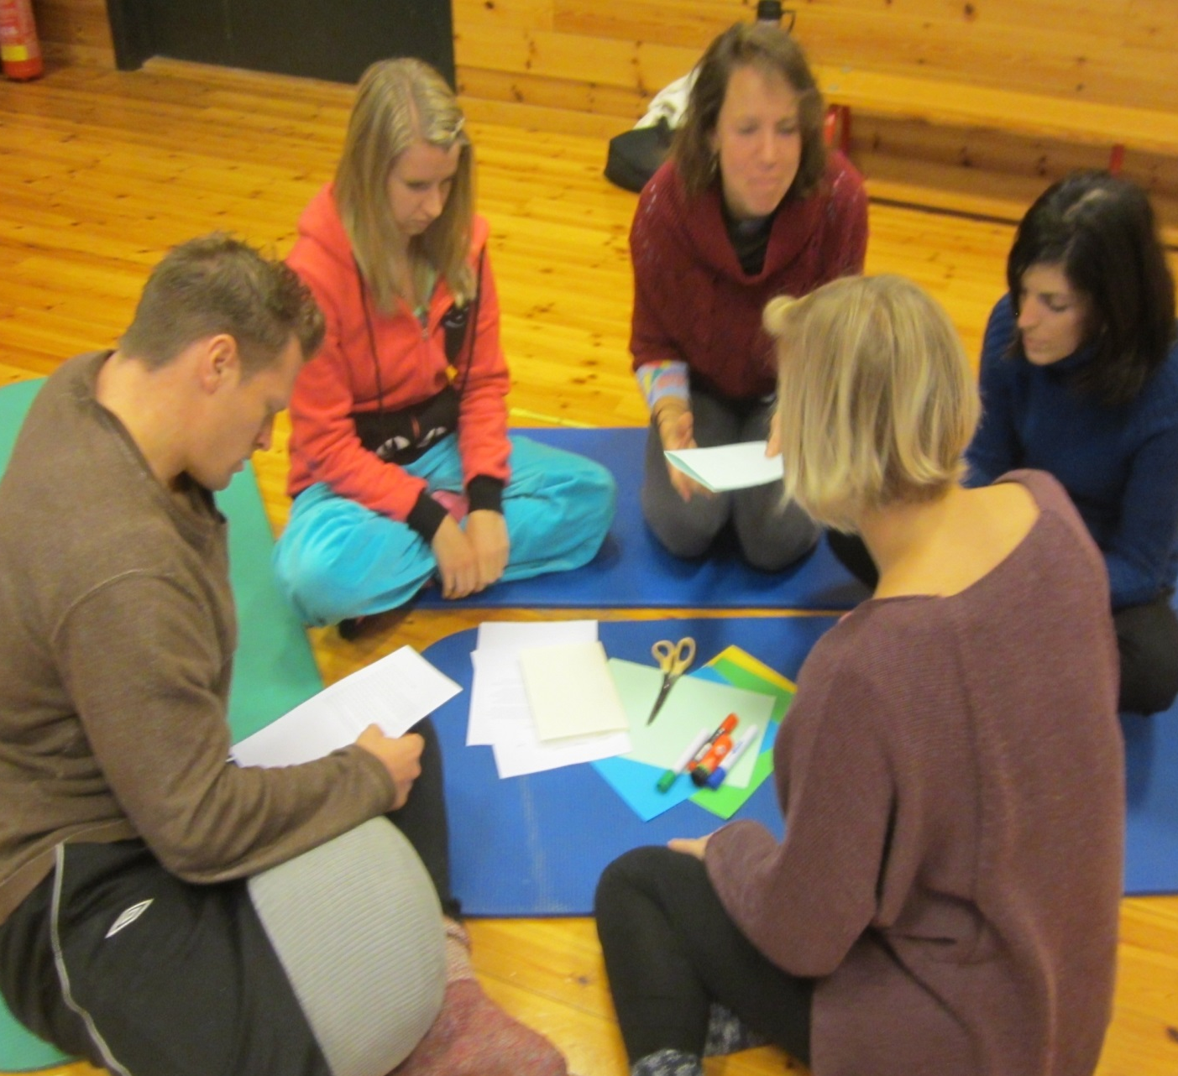
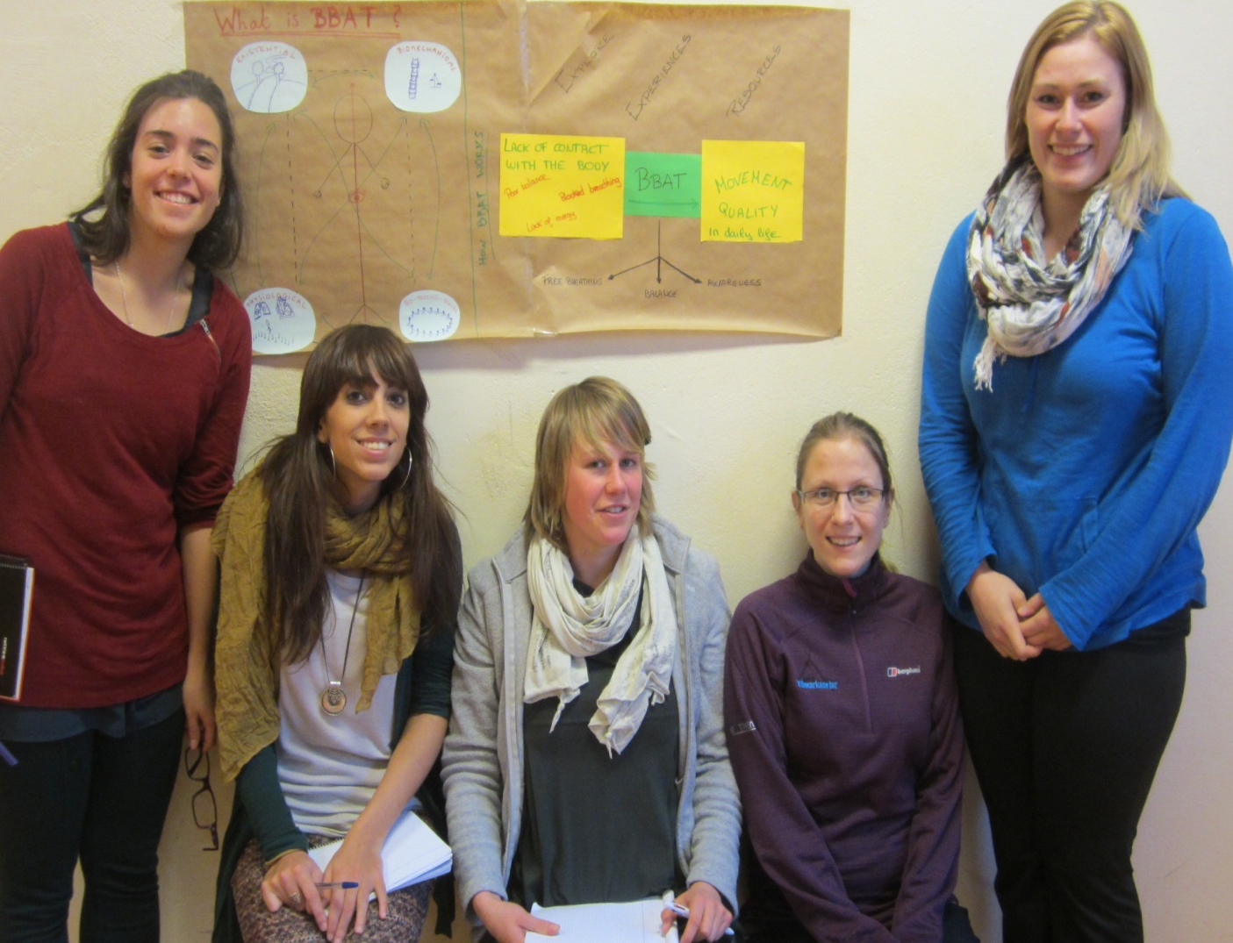
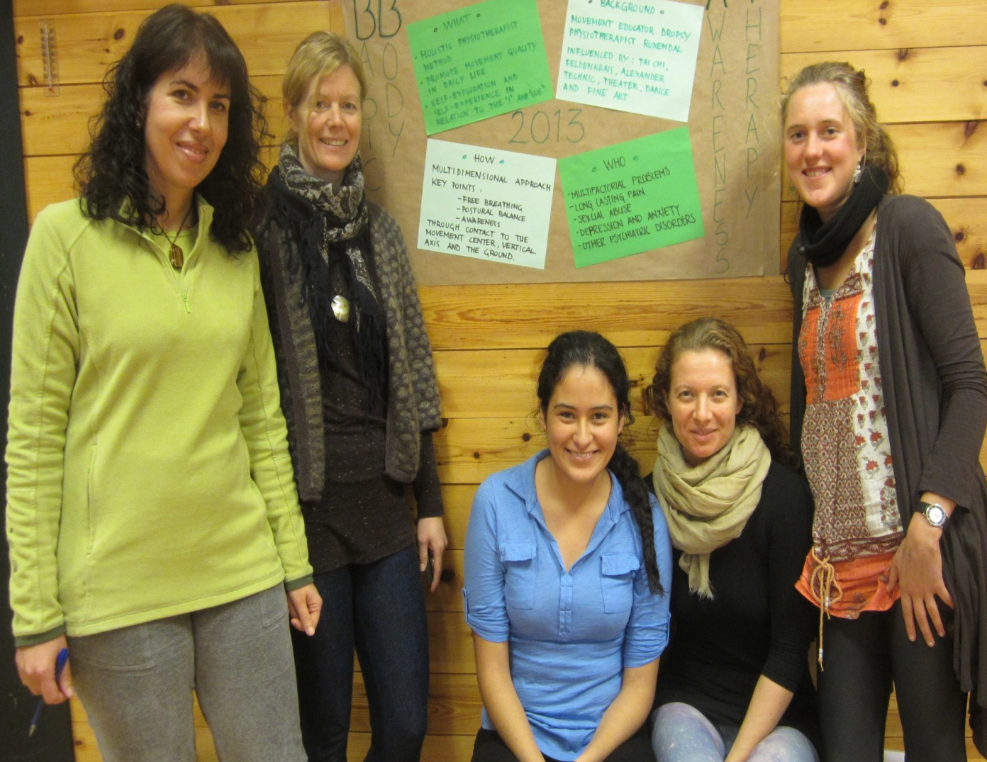
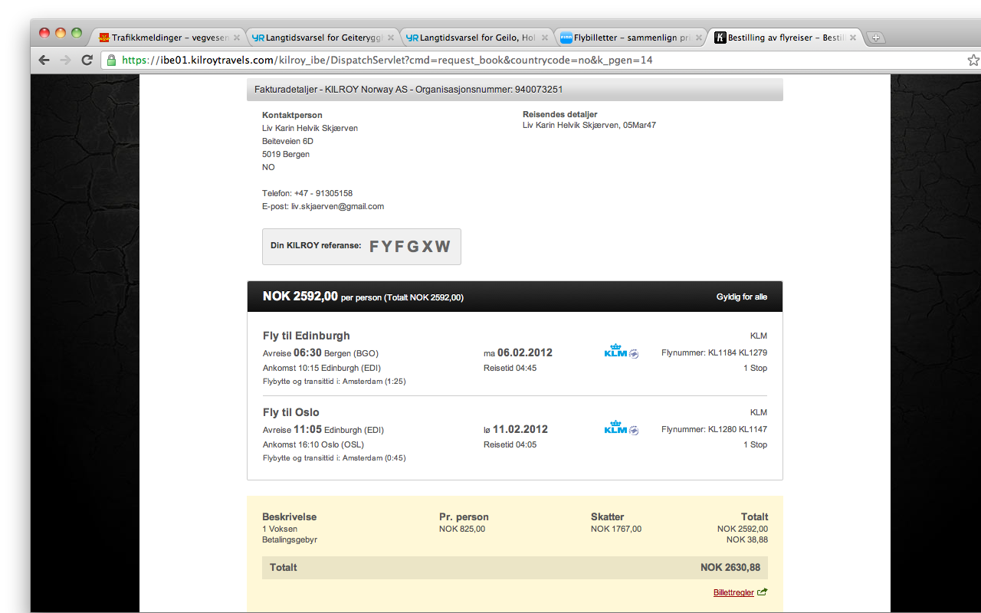
An international study program: Basic Body Awareness Methodology - a postgraduate education in Mental Health for English-speaking physiotherapists
Department of Occupational, Physiotherapy and Radiography
Faculty of Health and Social Sciences Bergen University College (HiB), Inndalsveien 28, 5063 Bergen, Norway
WELCOME to BERGEN
building an international network, meeting physiotherapy colleagues with the same interest and deepen your insight in human movement. The education can be included in a Master of Science Program for Physiotherapy in Psychiatry and Mental Health. The program offers 60 ECTS. There is no educational fee to HiB. Application March 2015; BBAM 2015 starts 19th of October 2015
Profile
Basic Body Awareness Methodology is a physiotherapeutic movement awareness approach that represents a humanistic approach to human movement, psychiatry and mental health care. The education challenges the student to develop self -awareness and skills in basic movement principles, including physical, physiological, psycho-socio-cultural and existential aspects of human movement
Target Group
The education is designed for physiotherapists working with persons suffering from muscle-skeletal problems, balance problems, psychiatric illness, psycho-somatic problems, long lasting pain, life-style problems, eating disorders, violence and sexual abuse. The education is for Physiotherapists who want to develop personal and professional.
Organization
The education is a 2 year, part-time education, with 3 block-periods at Bergen University College (HiB), in total 11 weeks. The period of self-study in between the blocks includes group-work on internet, clinical practice in individual-and group intervention, self-training in basic movement principles, study of theory, written assignments and project-work. Guidance by teacher at Bergen University College.
Block 1: Four weeks, October 2015 (19th of October – 13th of November)
Block 2: Four weeks, October 2016
Block 3: Three weeks, October 2017
Between Block 1 and Block 2, 10 months study; Focus: Individual intervention
Between Block 2 and Block 3, 10 months study; Focus: Group intervention
A Training Modell for Movement Quality
The education introduces a new pedagogical modell for training the skill of movement quality. It includes tools for systematic evaluation, the Body Awareness Raiting Scale (BARS), The Body Awareness Scale-Interview (BAS-I) and the treatment program for individual and group-intervention, Basic Body Awareness Therapy (BBAT). BBAM is evidence- and experience based.
Basic Body Awareness Therapy (BBAT)
The movement awareness program includes movements from daily life, lying, sitting, standing, walking, use of the voice, relational movements and massage. The program offers training situations for promoting healthy resources through movement: personal, cultural and existential. Therapeutic talk and reflection is integrated. The BBAT offers a strategy to make the physiotherapist as well as the patient/ client equipped to handle life more ably.
2013: Physiotherapists from Mexico, Portugal, Spain, Belgium, Netherland, Estonia, Finland, UK, Denmark, Norway
Contact: Liv Helvik Skjærven: lhs@hib.no

